Slide 1
MOVE HMI
© 2021 John Sefcovic and Oakland Community College.

Slide 2
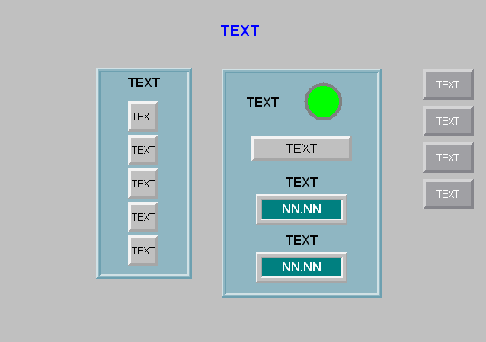
Move HMI
Panel 1 Template
Delete unused objects

Slide 3
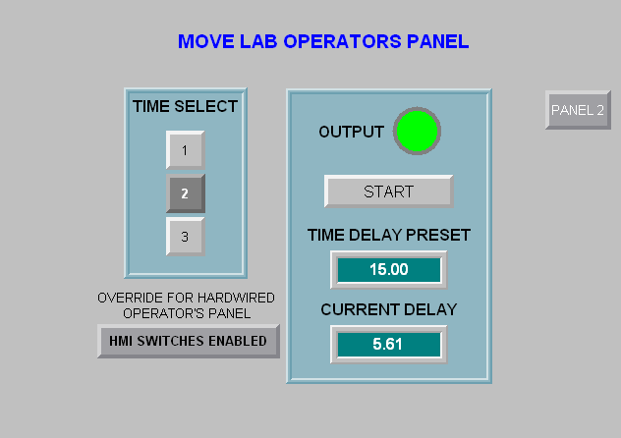
Move HMI
Panel 1 Running
Define Text, Attributes, Navigation, and Tags
Add Maintained Button object and define Attributes and Tag

Slide 4
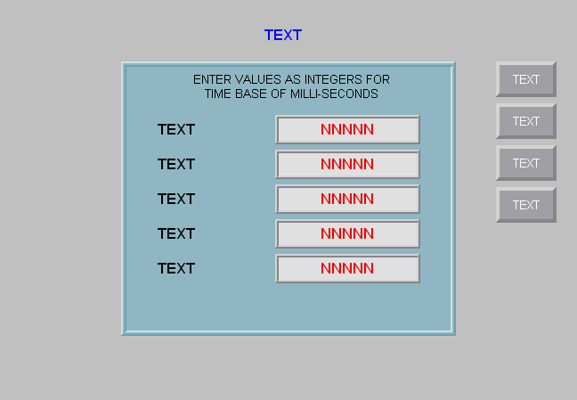
Move HMI
Panel 2 Template
Delete unused objects

Slide 5
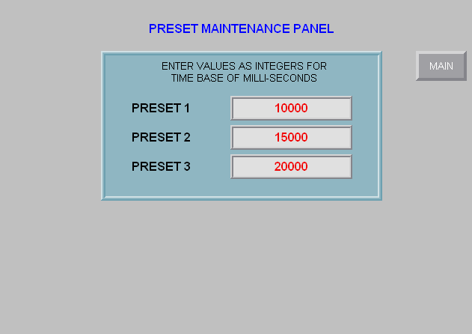
Move HMI
Panel 2 Running
Define Text, Attributes, Navigation, and Tags

Slide 6
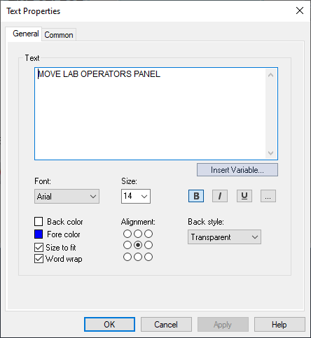
Move HMI
Summary of Object Properties - Text
Enter Text and set Font Attributes
Multiple Text objects on both panels

Slide 7
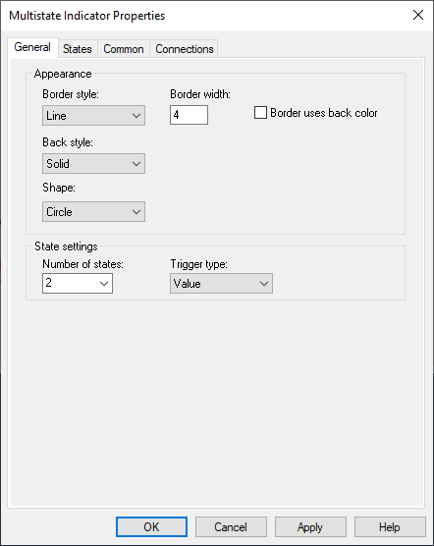
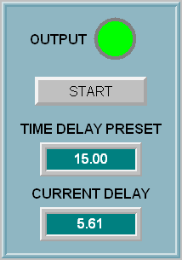
Move HMI
Summary of Object Properties - Indicator
Move HMI
Define Appearance and Number of States

Slide 8
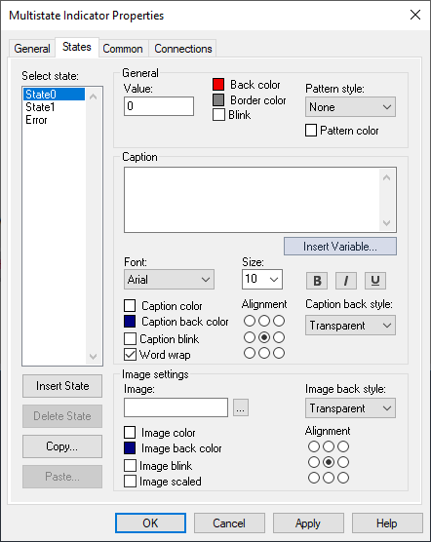
Move HMI
Summary of Object Properties - Indicator
Move HMI
State 0: set Back and Boarder Color Attributes

Slide 9
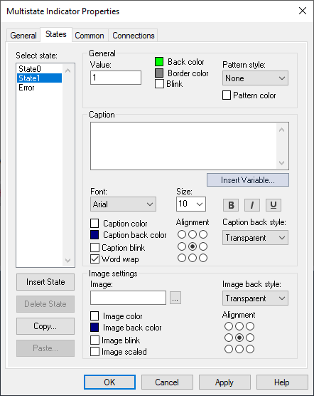
Move HMI
Summary of Object Properties - Indicator
Move HMI
State 1: set Back and Boarder Color Attributes

Slide 10
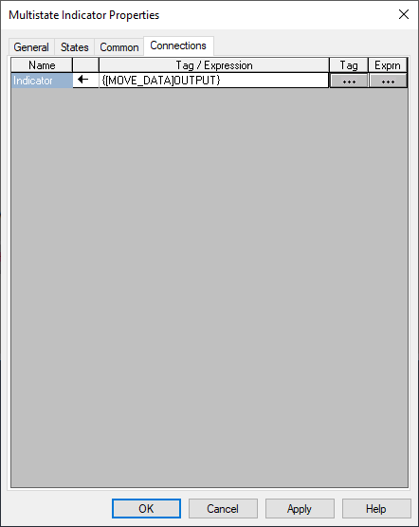
Move HMI
Summary of Object Properties - Indicator
Move HMI
Define Data Tag

Slide 11
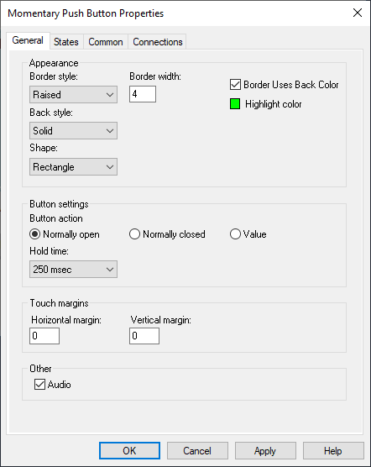
Move HMI
Summary of Object Properties – Momentary Pushbutton
Define Appearance and Button Settings

Slide 12
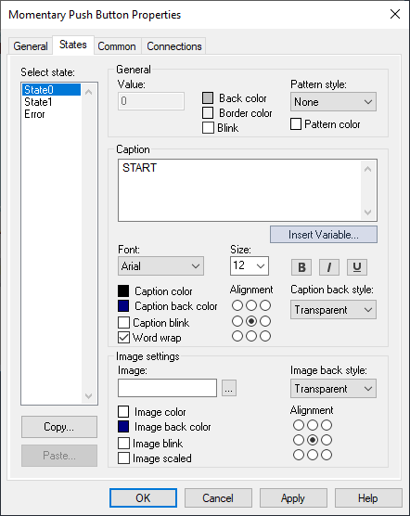
Move HMI
Summary of Object Properties – Momentary Pushbutton
State 0: set Back Color Attributes and enter Caption and Caption Color.

Slide 13
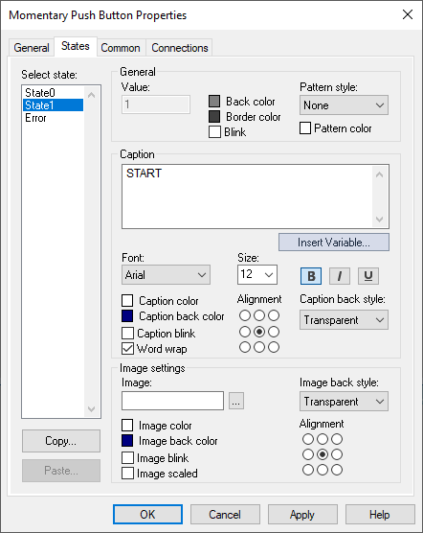
Move HMI
Summary of Object Properties – Momentary Pushbutton
State 0: set Back Color Attributes and enter Caption.
Notice change in Caption Color.

Slide 14
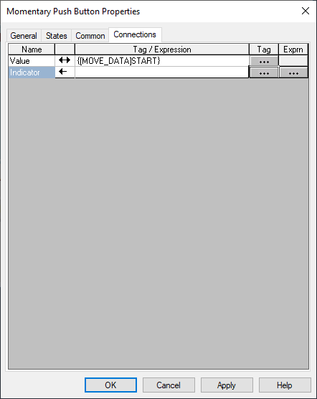
Move HMI
Summary of Object Properties – Momentary Pushbutton
Define Data Tag

Slide 15
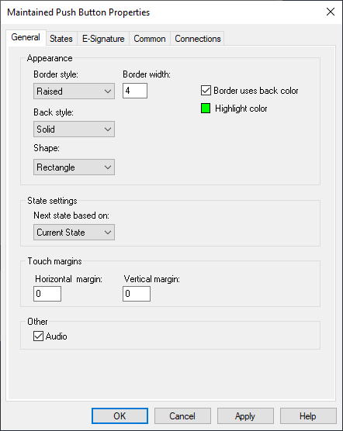

Move HMI
Summary of Object Properties – Maintained Pushbutton
Define Appearance
A Maintained Button to Enable/Disable HMI switches.

Slide 16
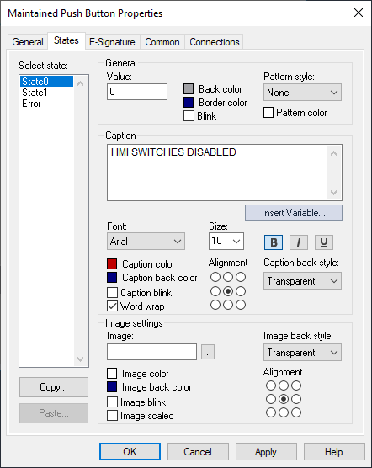
Move HMI
Summary of Object Properties – Maintained Pushbutton
State 0: set Back Color Attributes and enter Caption and Caption Color.

Slide 17
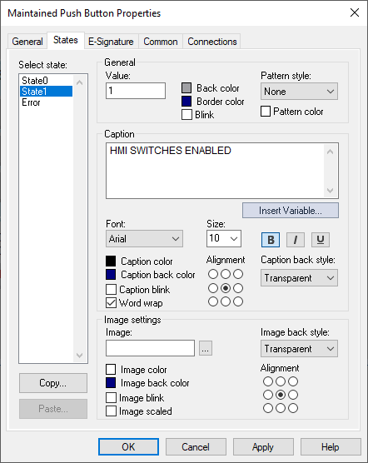
Move HMI
Summary of Object Properties – Maintained Pushbutton
State 0: set Back Color Attributes and enter Caption.
Notice change in Caption Color.

Slide 18
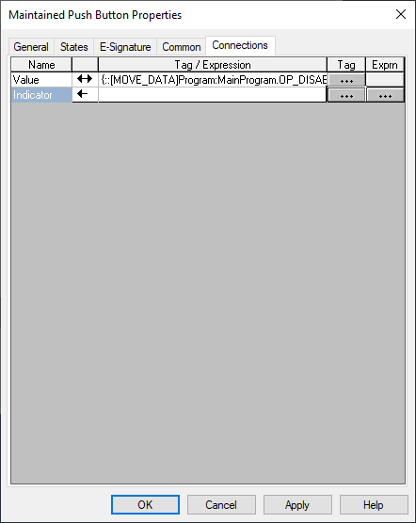
Move HMI
Summary of Object Properties – Maintained Pushbutton
Define Data Tag

Slide 19
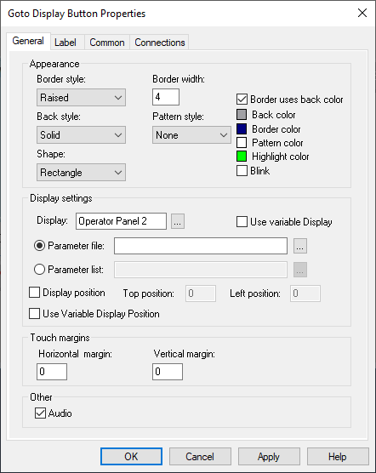

Move HMI
Summary of Object Properties – Navigation Goto Screen
Define Appearance
This button is on Operator Panel 1, Main, and will cause Operator Panel 2 to be displayed.
Define Display Settings the screen to goto.

Slide 20
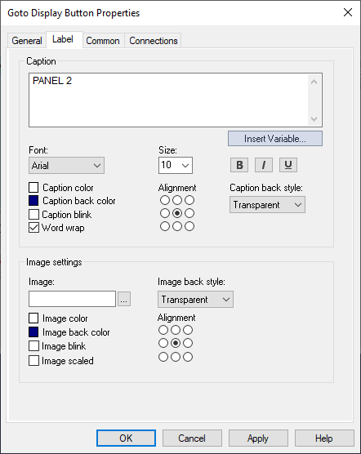
Move HMI
Summary of Object Properties – Navigation Goto Screen
Enter the Caption.

Slide 21


Move HMI
Summary of Object Properties – Navigation Goto Screen
Define Appearance
This button is on Operator Panel 2 and will cause Operator Panel 1, Main, to be displayed.
Define Display Settings the screen to goto.

Slide 22

Move HMI
Summary of Object Properties – Navigation Goto Screen
Enter the Caption.

Slide 23
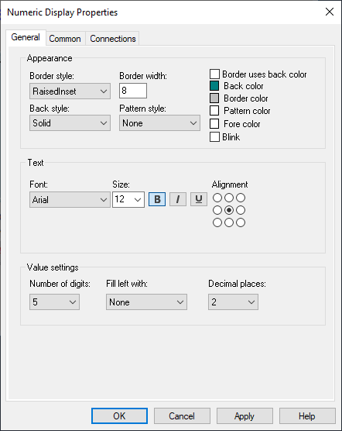
Move HMI
Summary of Object Properties – Numeric Display
Define Appearance
Define the number and format of digits to display.

Slide 24
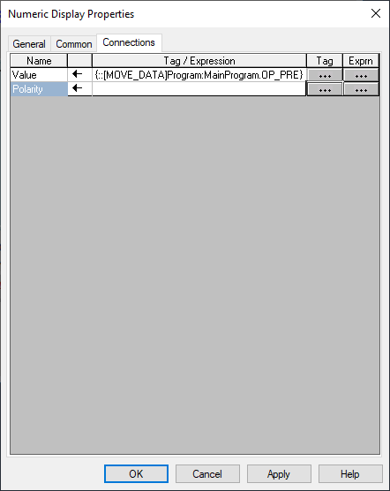
Move HMI
Summary of Object Properties – Numeric Display

Slide 25
Move HMI
Summary of Object Properties – Numeric Display
Tag for TIME DELAY PRESET
Tag for CURRENT DELAY

Slide 26
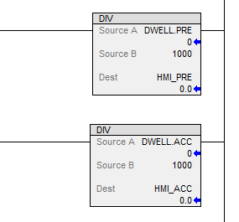
Move HMI
Summary of Object Properties – Numeric Display
The Divide (DIV)Instruction changes the Timer’s Preset and Accumulated value to actual time for the Numeric Display objects.
Tag for TIME DELAY PRESET
Tag for CURRENT DELAY

Slide 27
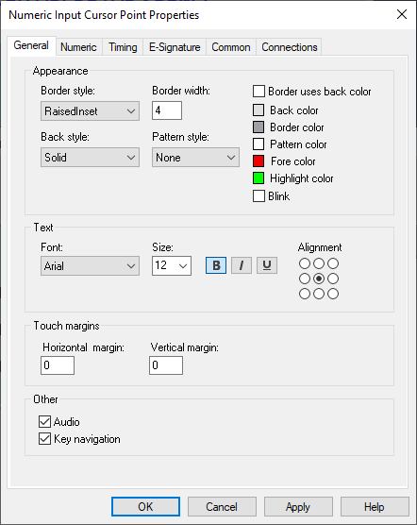
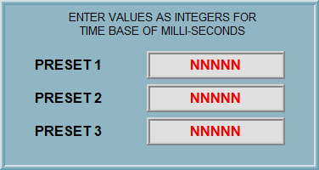
Move HMI
Summary of Object Properties – Numeric Input
Enter the properties for Appearance.
Enter Text properties for the numbers.

Slide 28
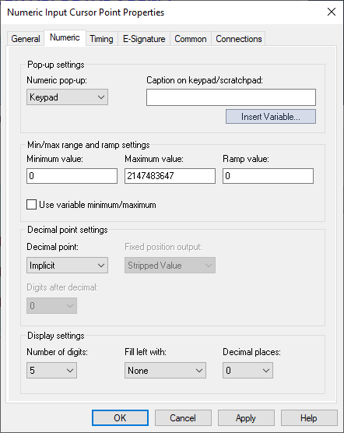
Move HMI
Summary of Object Properties – Numeric Input
Select data entry type device.
Note: for this lab no limits will be set.
Define the number and format of digits to display.

Slide 29
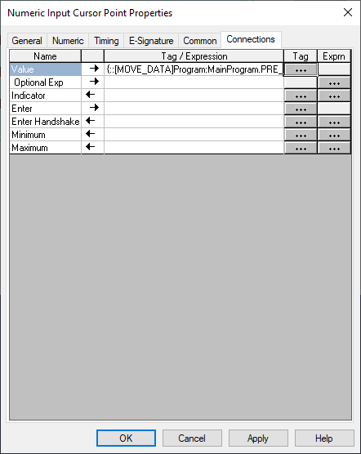
Move HMI
Summary of Object Properties – Numeric Input
Enter the Connections shortcut data tag.

Slide 30
Move HMI
Summary of Object Properties – Numeric Input
First Numeric Input Tag
Second Numeric Input Tag
Third Numeric Input Tag

Slide 31
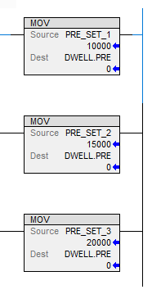
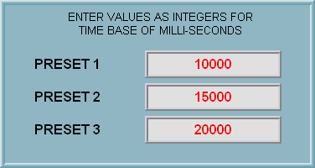
Move HMI
Summary of Object Properties – Numeric Input
The Numeric Input objects are used to enter the Source value used by the Move (MOV) instruction for the Timer’s Preset.
First Numeric Input Tag
Second Numeric Input Tag
Third Numeric Input Tag

Slide 32
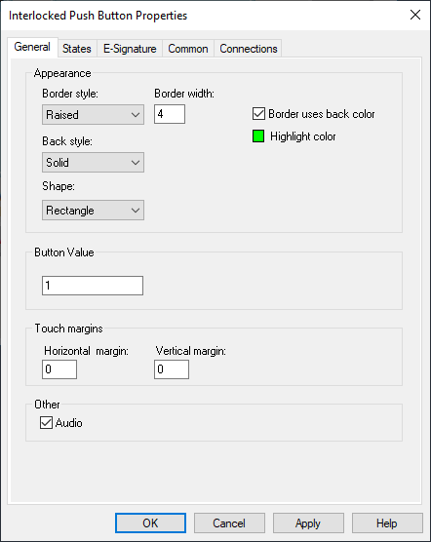
Move HMI
Summary of Object Properties – Interlocked Pushbutton
Enter the properties for Appearance.
Enter the Button Value, each button’s value must be unique.

Slide 33
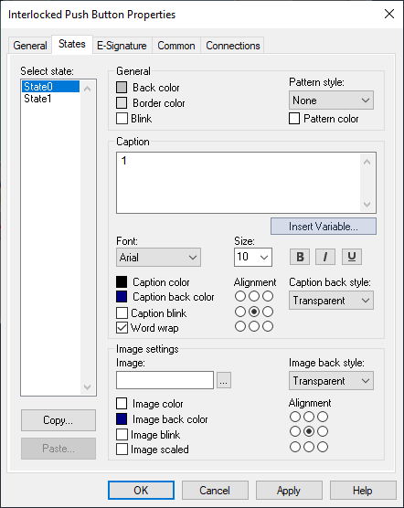
Move HMI
New Object Properties – Interlocked Pushbutton
Enter the State 0 properties
Notice the Caption.

Slide 34
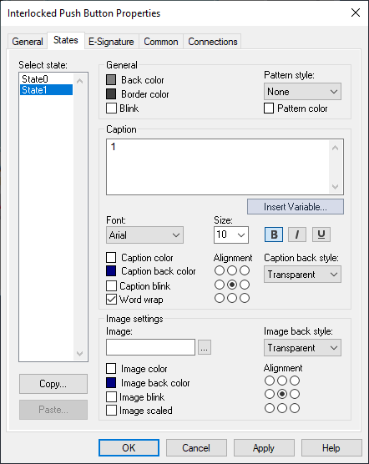
Move HMI
New Object Properties – Interlocked Pushbutton
Enter the State 1 properties
Notice the Caption.

Slide 35
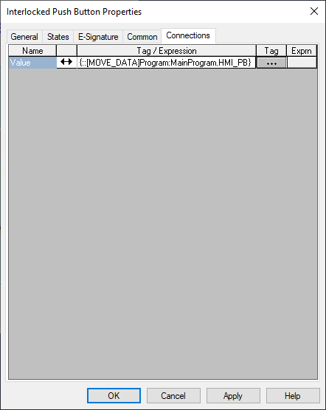
Move HMI
New Object Properties – Interlocked Pushbutton
Enter the Connections Shortcut Data Tag.

Slide 36
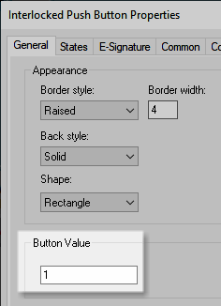

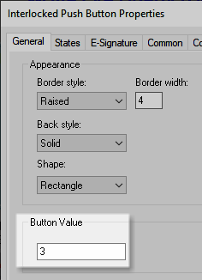
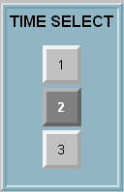
Move HMI
New Object Properties – Interlocked Pushbutton
Notice each of the Interlock Push Buttons have a unique number value for its Button Value.

Slide 37
Move HMI
New Object Properties – Interlocked Pushbutton
All Interlock Push Buttons are connected to the same data tag.
In this lab: HMI_PB

Slide 38
Move HMI
New Object Properties – Interlocked Pushbutton
When a Interlocked Push Button is pressed, its value is sent to the tag.
In this example, the value of 2 is sent to the HMI_PB tag.
Notice the buttons are inside a Panel objects, the panel is what defines these buttons are interlocked together.

Slide 39
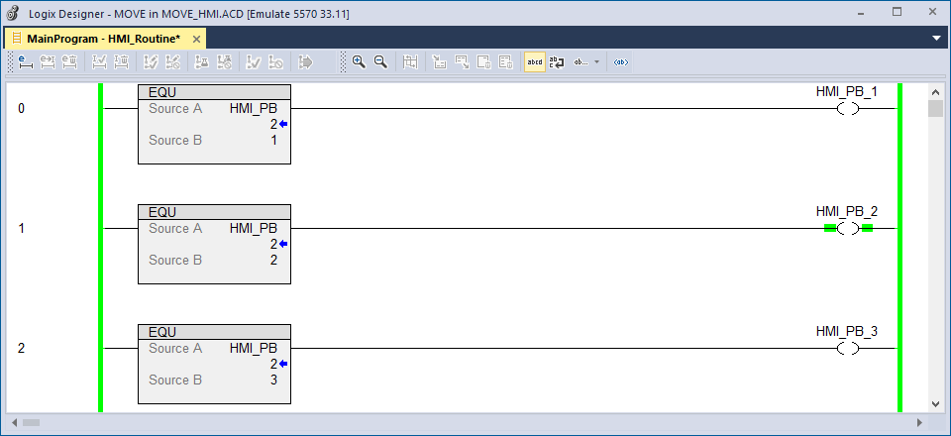
Move HMI
New Object Properties – Interlocked Pushbutton
EQU instructions are used to determine the value at the tag OP_PB to set an associated internal tag OP_PB_n.

Slide 40
Move HMI
New Object Properties – Interlocked Pushbutton
EQU instructions are used to determine the value at the tag OP_PB to set an associated internal tag OP_PB_n.
In this example the Second Interlocked Pushbutton is pressed. Setting the Internal Boolean HMI_PB_2 to record
the second button is active.

Slide 41
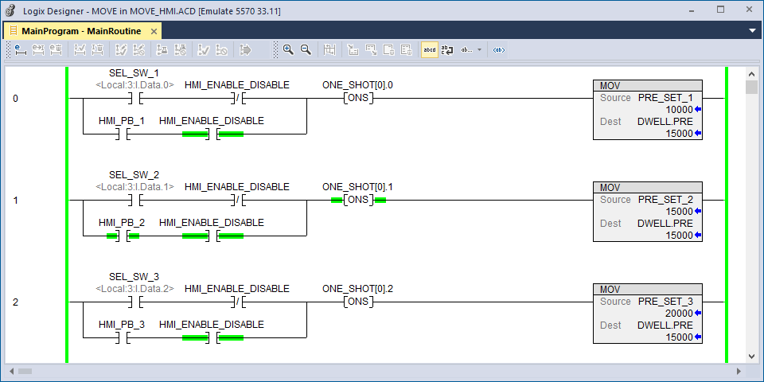
Move HMI
New Object Properties – Interlocked Pushbutton
The internal tag OP_PB_n is then used to control the value moved into the timer preset.

Slide 42
Move HMI
New Object Properties – Interlocked Pushbutton
The internal tag OP_PB_n is then used to control the value moved into the timer preset.
The set Internal Boolean HMI_PB_2 has the MOV instruction copy the PRE_SET_2 value into the DWELL timer’s Preset .PRE.

Slide 43
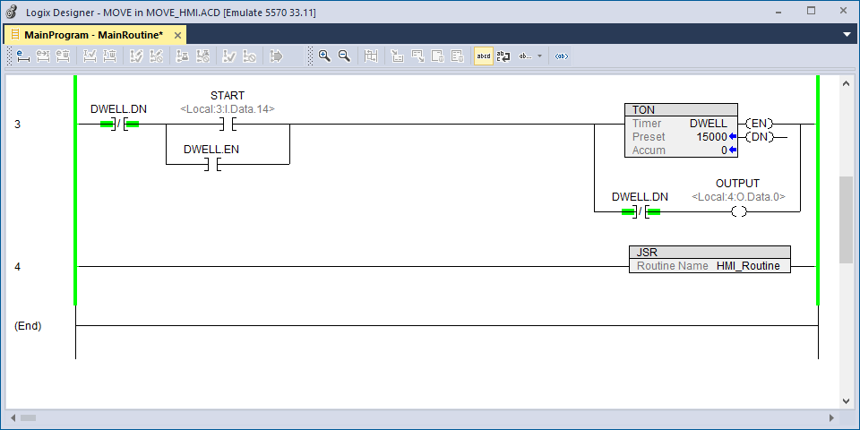
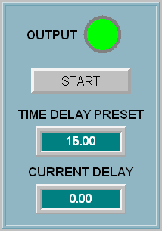
Move HMI
New Object Properties – Interlocked Pushbutton
The Timer’s Preset is at a value of 15000.

Slide 44
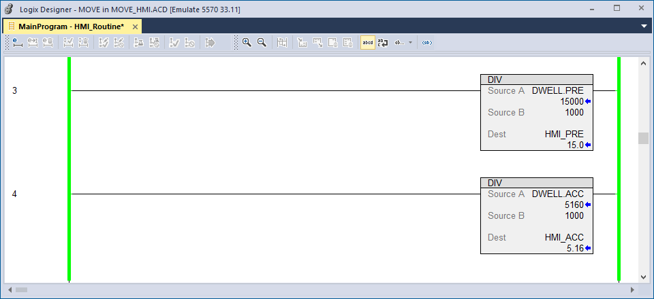
Move HMI
Numeric Display
Math divide DIV instructions convert the milliseconds of the timer to a standard readable format. Notice the results need to be placed into holding tags.

Slide 45
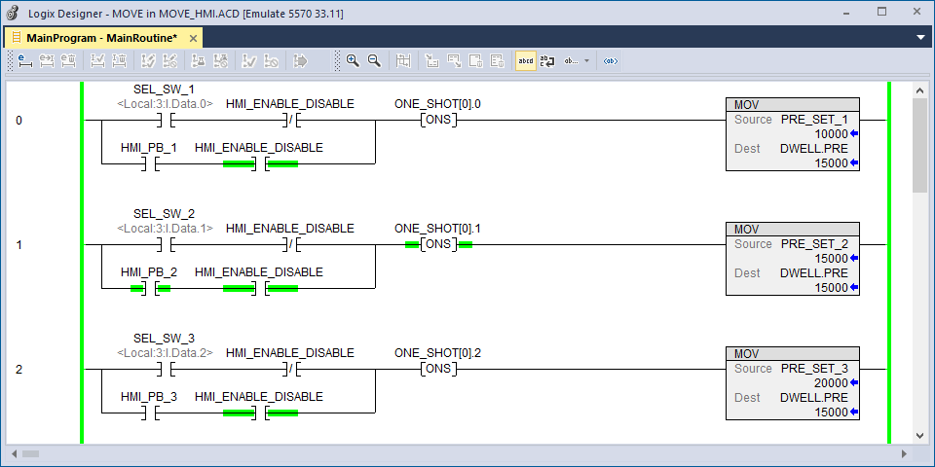
Move HMI
HMI Enabled
On top branch for each of the rungs, the HMI_DISABLE_SS instruction is false, preventing a conflicting signal from the hardwired backup selector switch.

Slide 46
Move HMI
HMI Enabled
On top branch for each of the rungs, the HMI_DISABLE_SS instruction is false, preventing a conflicting signal from the hardwired backup selector switch.
If the HMI is operational, the Enable/Disabled tag has a logic 1 value.

Slide 47
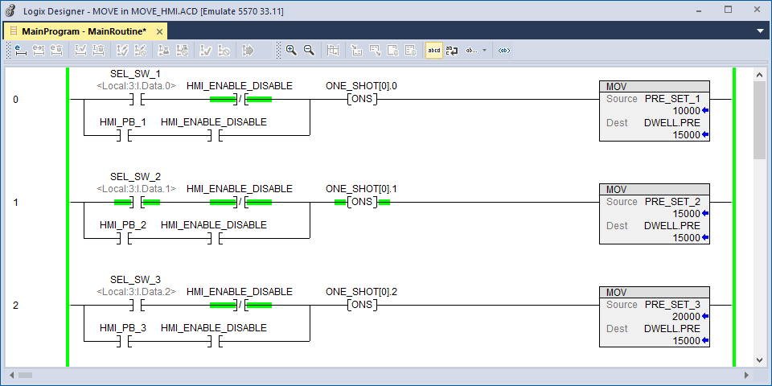
Move HMI
HMI Enabled
The tag HMI_DISABLE_SS instruction is true allowing the signal from the hardwired backup selector switch to control the value moved into the timer preset.

Slide 48
Move HMI
HMI Enabled
The tag HMI_DISABLE_SS instruction is true allowing the signal from the hardwired backup selector switch to control the value moved into the timer preset.
In this case the HMI is not operational, and no signal is sent to the tag, resulting in a logic 0 value.

